Slide 1
Retail & Market Analysis
Prakhar Gupta
For IIIT-B & Upgrad

Slide 2
Objective
To identify top products that contribute to the revenue.
To analyze the purchase behavior of individual customers and estimate with relative certainty.
To analyse combination of products to increase revenue.

Slide 3
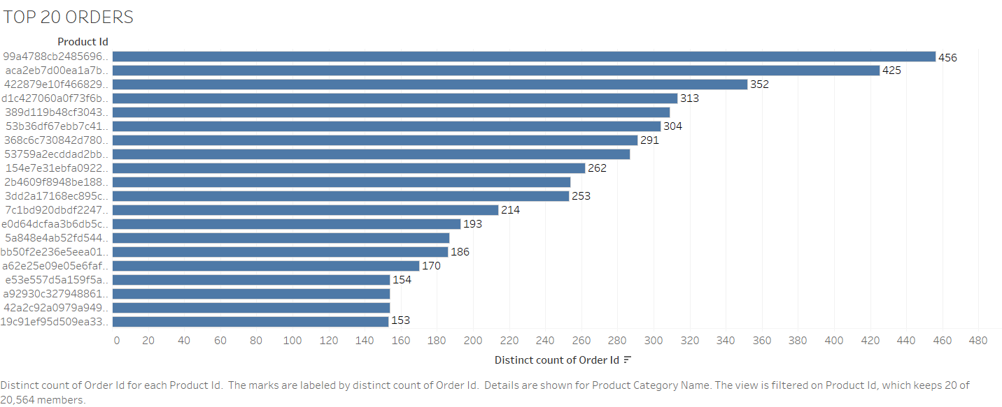

Slide 4
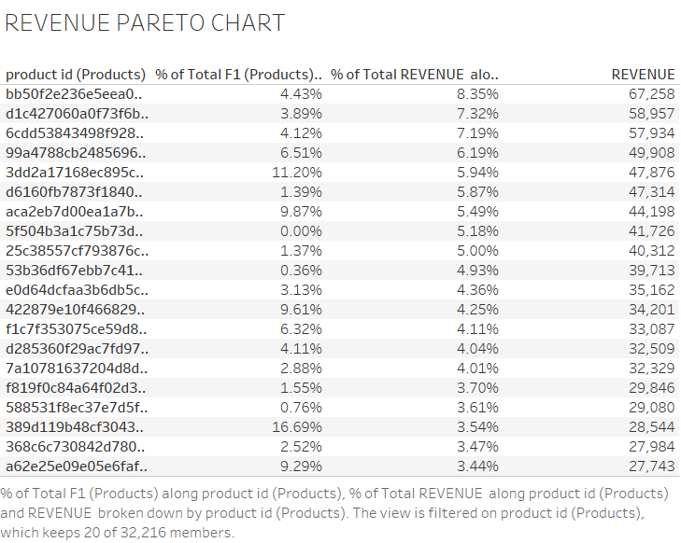
Percentage of total revenue and percentage of total product along with revenue for individual product is been shown by this Pareto chart

Slide 5
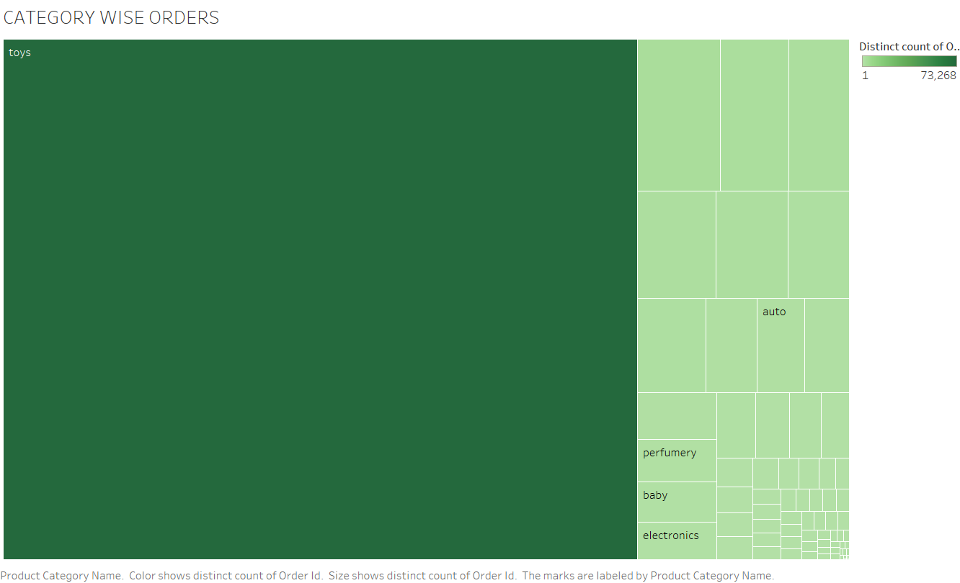

Slide 6
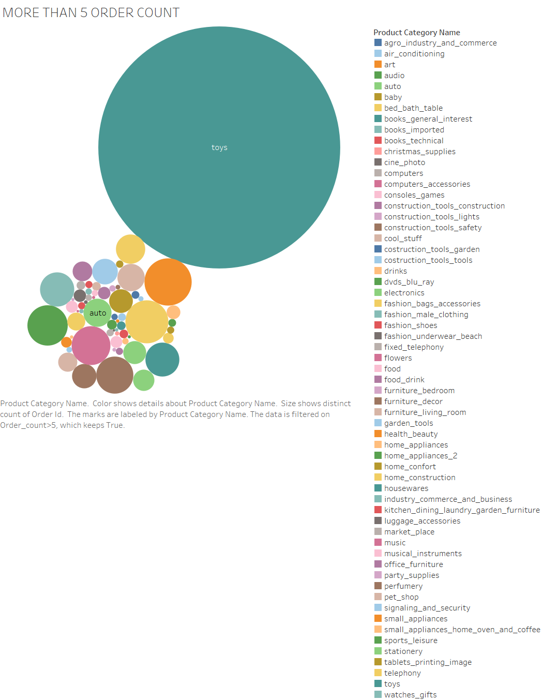
Toys category has the maximum number of products ordered.
Followed by health_beauty & sports_leisure

Slide 7
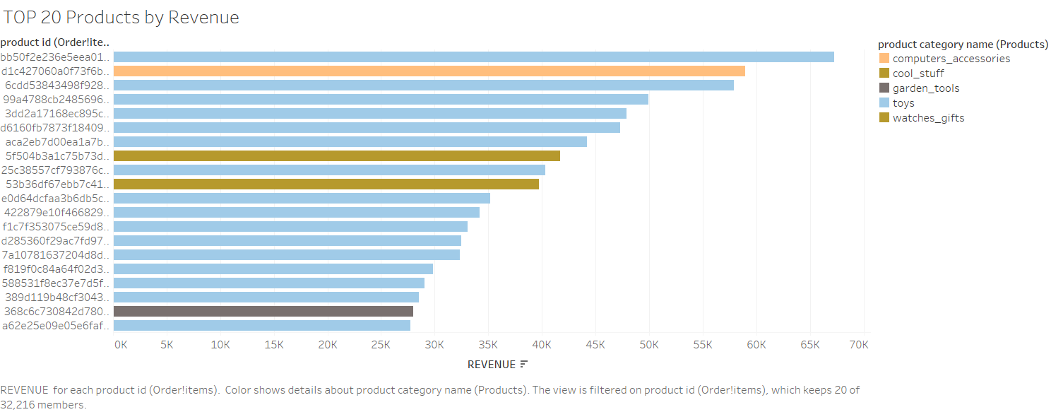
Toys contribute to 80% of the revenue

Slide 8
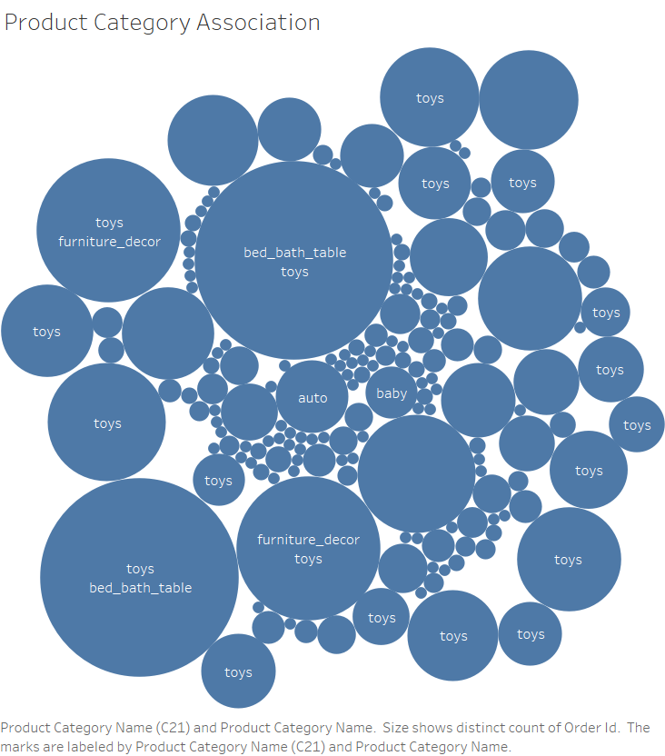
After combining the data we get bed_bath_table and toys has the highest distinct count of orders.

Slide 9
Insights
Toys contribute to 80% of revenue and 20% of sales
Some amount of focus should be made towards other top products which have a good contribution to revenue.
We should make combination and produce combos of top categories frequently bought ex: toys with bed bath and table

Slide 10
Thank You

